Slide 1
Semiconductors and their Metal Contacts
Summer training presentation by:
Manthan Chauhan
Enrollment Number 02614802816

Slide 2
Classification of Metal – Semiconductor junctions
Metal – Semiconductor Junctions
Schottky Junctions
Ohmic contacts

Slide 3
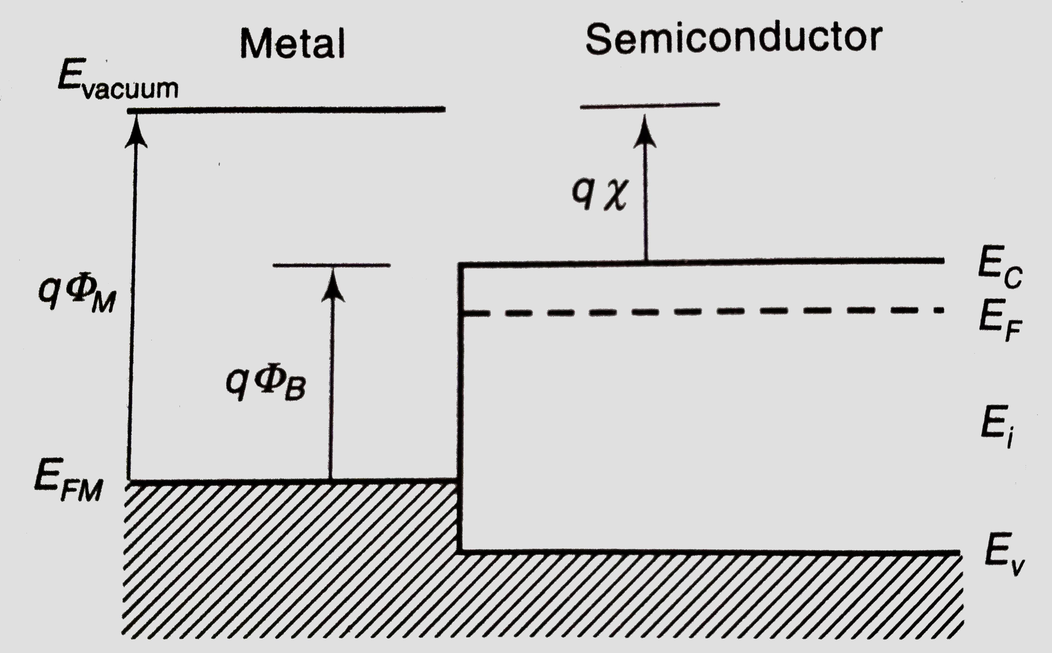
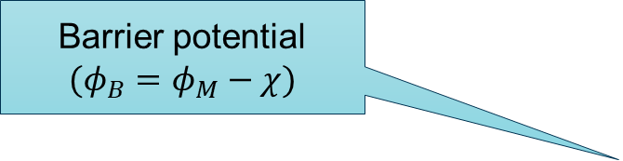
Structure of Metal – Semiconductor Junctions
Before the establishment of Thermal Equilibrium
Metal work function
Electron affinity of semiconductor
Barrier potential
$$(φ_{B}=φ_{M}−χ)$$
Fermi level of metal

Slide 4
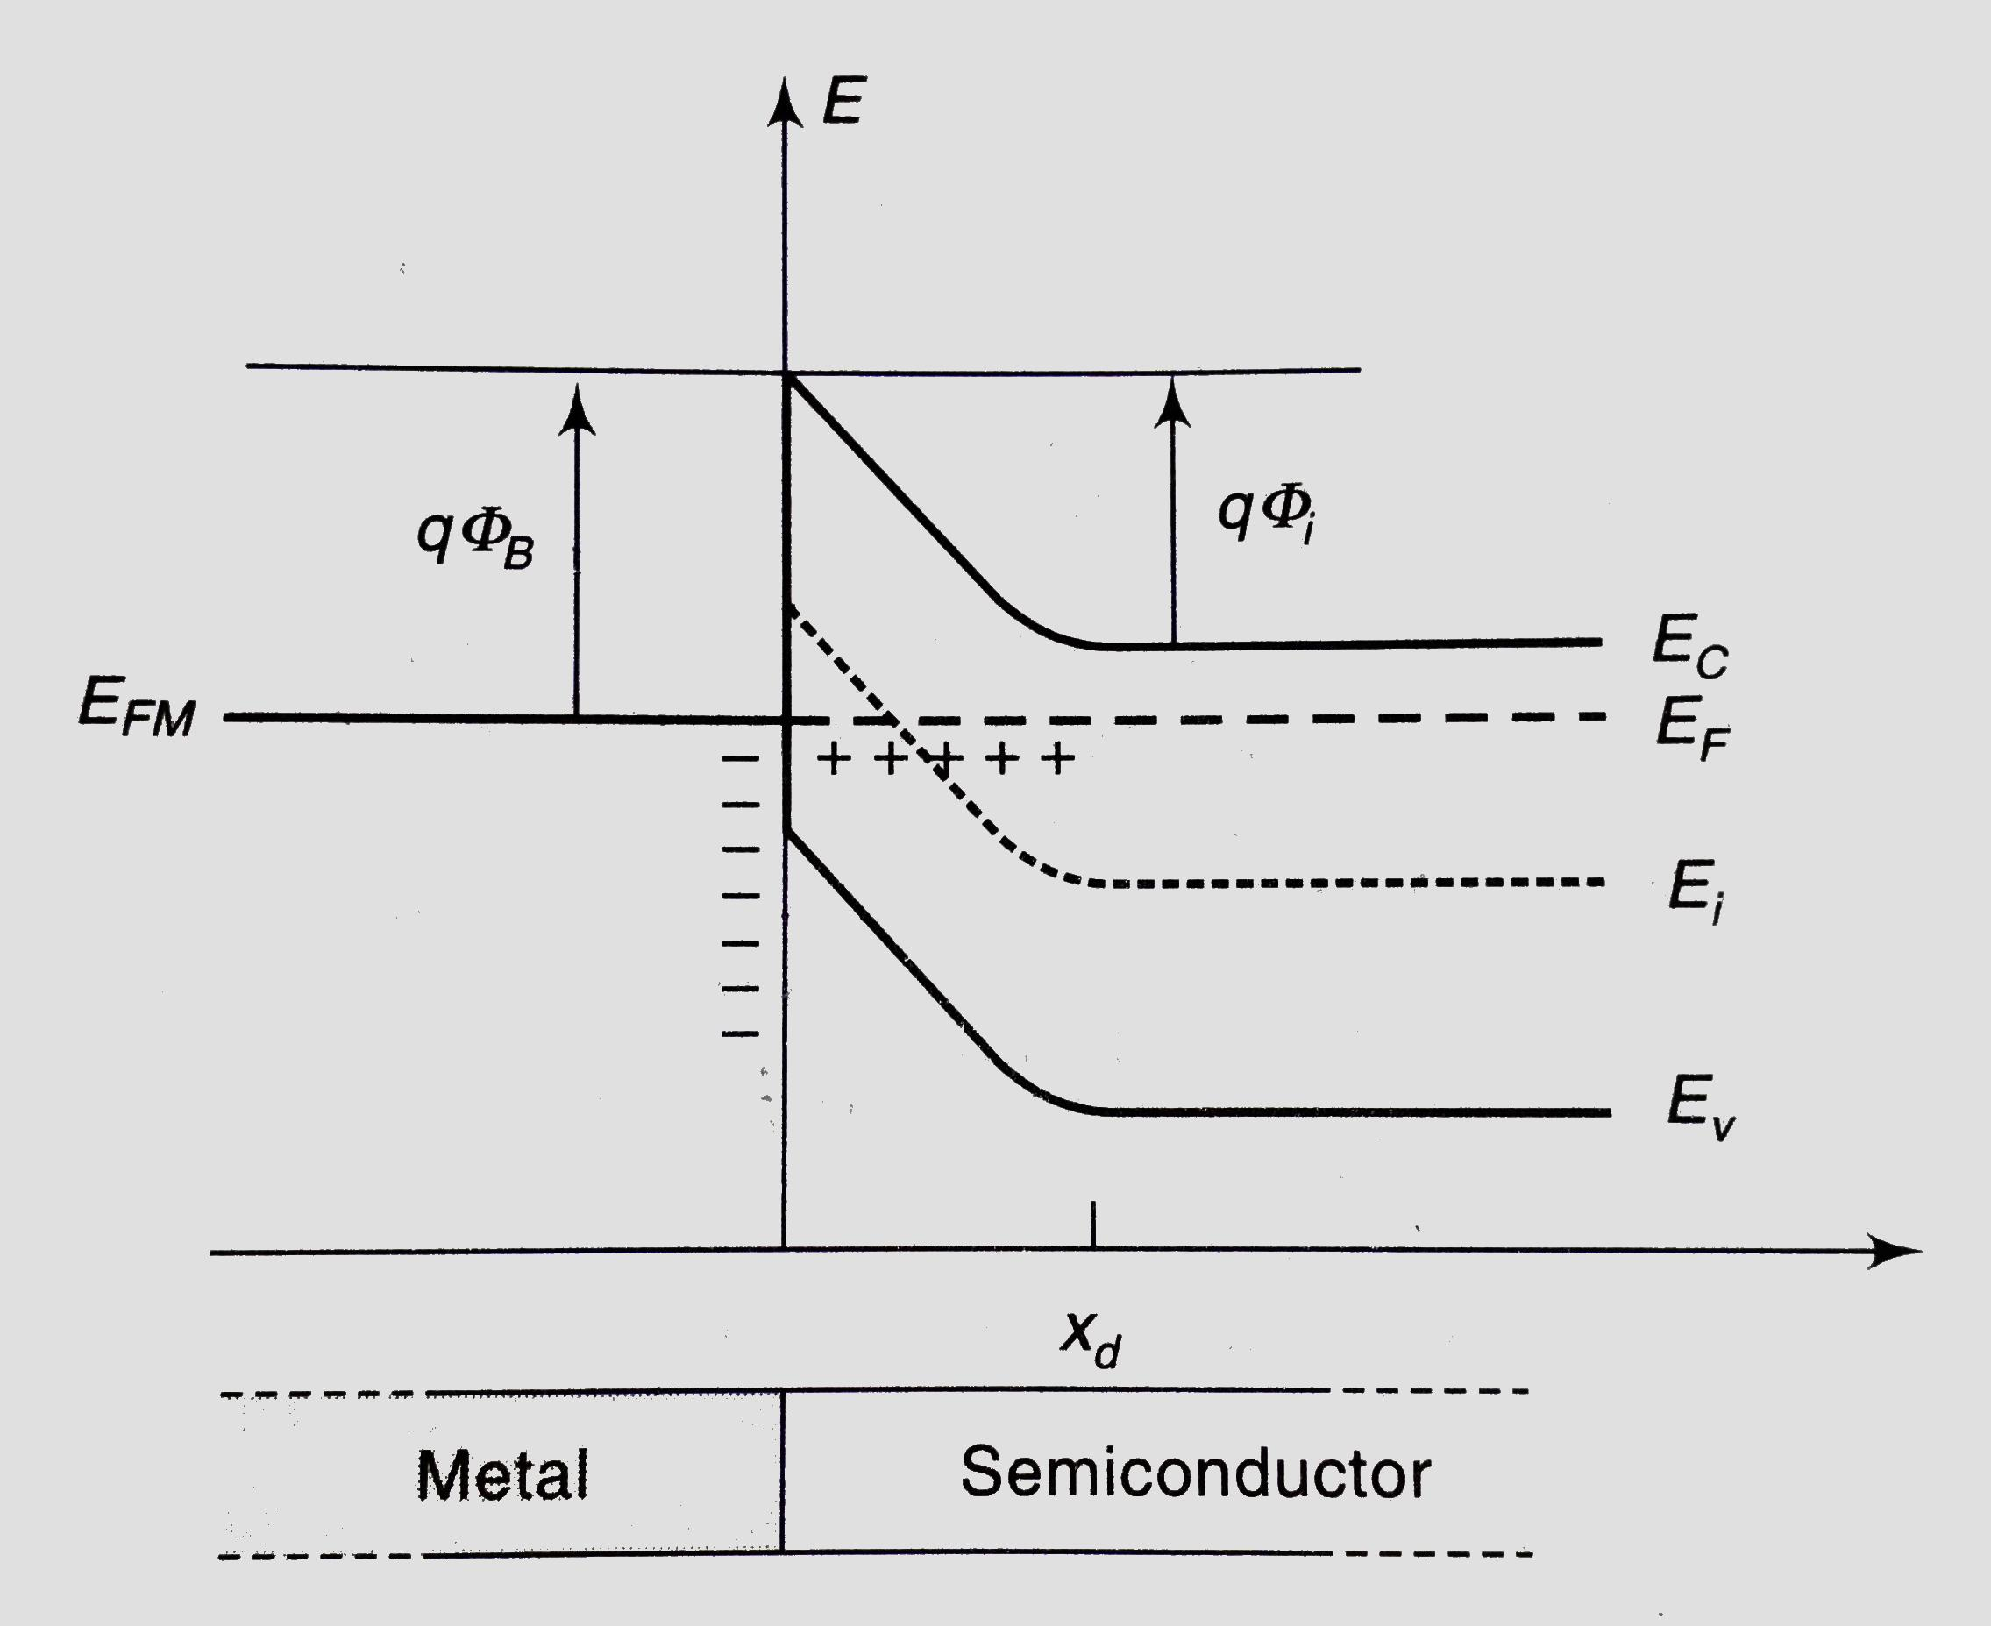
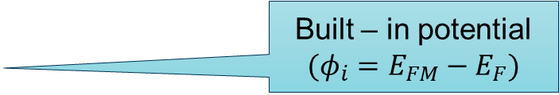
Structure of Metal – Semiconductor Junctions
After the establishment of Thermal Equilibrium
Built – in potential
$$(φ_{i}=E_{FM}−E_{F})$$
Depletion edge

Slide 5
Properties in Focus:
Forward Voltage Drop
Voltage Drop across the diode in forward bias condition
Junction Capacitance
Capacitance due to the electric charge stored in junction
Reverse Recovery Time
Time taken to switch a diode from conducting to non – conducting state
Working Temperature
Maximum temperature at which the device works without getting damaged
Reverse Leakage Current
Current through the junction in reversed bias

Slide 6
Forward Voltage Drop
Used in Power Rectifiers
1) Less power is wasted than if ordinary PN junction diodes were used.
2) Less heat needs to be dissipated.
3) Smaller heat sinks may be incorporated in the design.
4) Less cost and compact designs.
BAT54SHMFH

Slide 7
Junction Capacitance
Used in RF Detectors
Low capacitance of Schottky barrier diodes make them ideal for RF detectors.

Slide 8

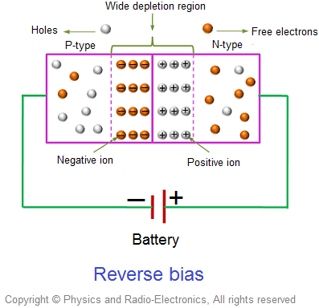
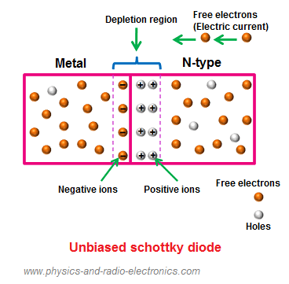
Reverse Recovery Time
Used in RF Detectors
Low capacitance of Schottky barrier diodes make them ideal for RF detectors.
Reverse biased PN junction diode
Reversed biased Schottky diode

Slide 9
Reverse Leakage current and Working temperature
Working temperature: 125 to 175 ͦ C
Leakage current increases significantly with increase in temperature.
Due to high reverse leakage current, high temperature lead to thermal instability.

Slide 10
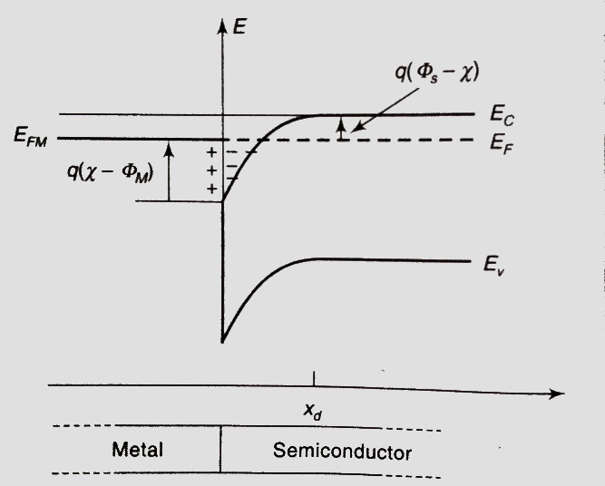
Ohmic Contacts
Conducts current in and out of the semiconductor
Available energy states for tunneling of electrons

Slide 11
Thank You

Slide 12
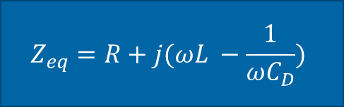

Circuit Diagram for determination of Junction Capacitance with diode replaced with equivalent RC model
$$Z_{eq}=R+j(ωL −\frac{1}{ωC_{D}})$$
$$ω^{2}=\frac{1}{LC}$$

